Slide 1


Control
Sample
Figure S1: Representative density plots of gated SYBR polygon derived bacterial counts for a SYBR stained .2µm filtered milliq control and a SYBR stained sample.

Slide 2
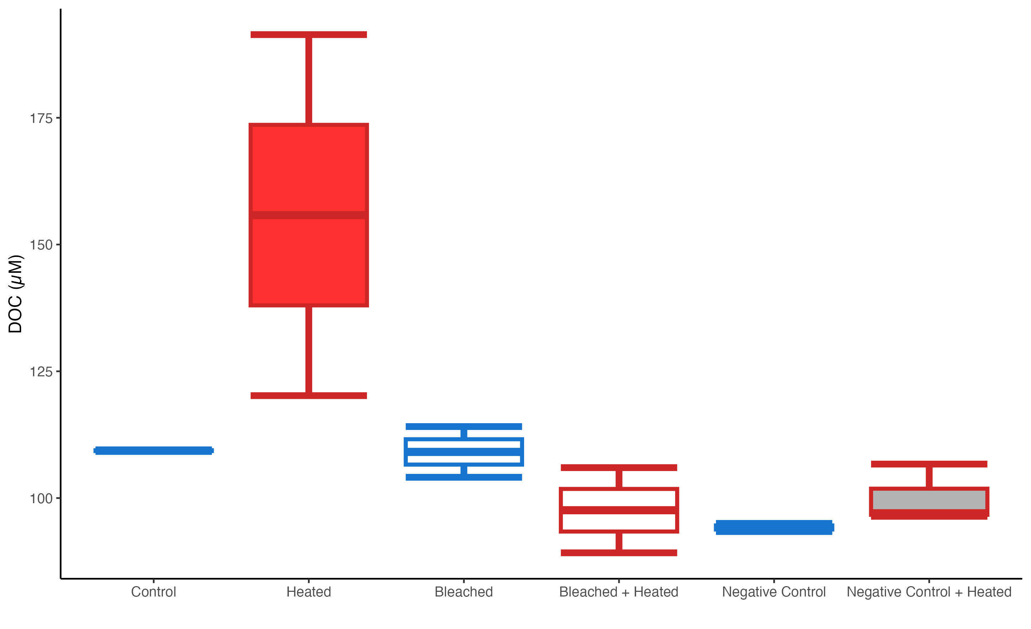
S1
Figure S2: Box and whisker plots of raw DOC exudate concentrations (µM) for the 6 treatments.µ

Slide 3
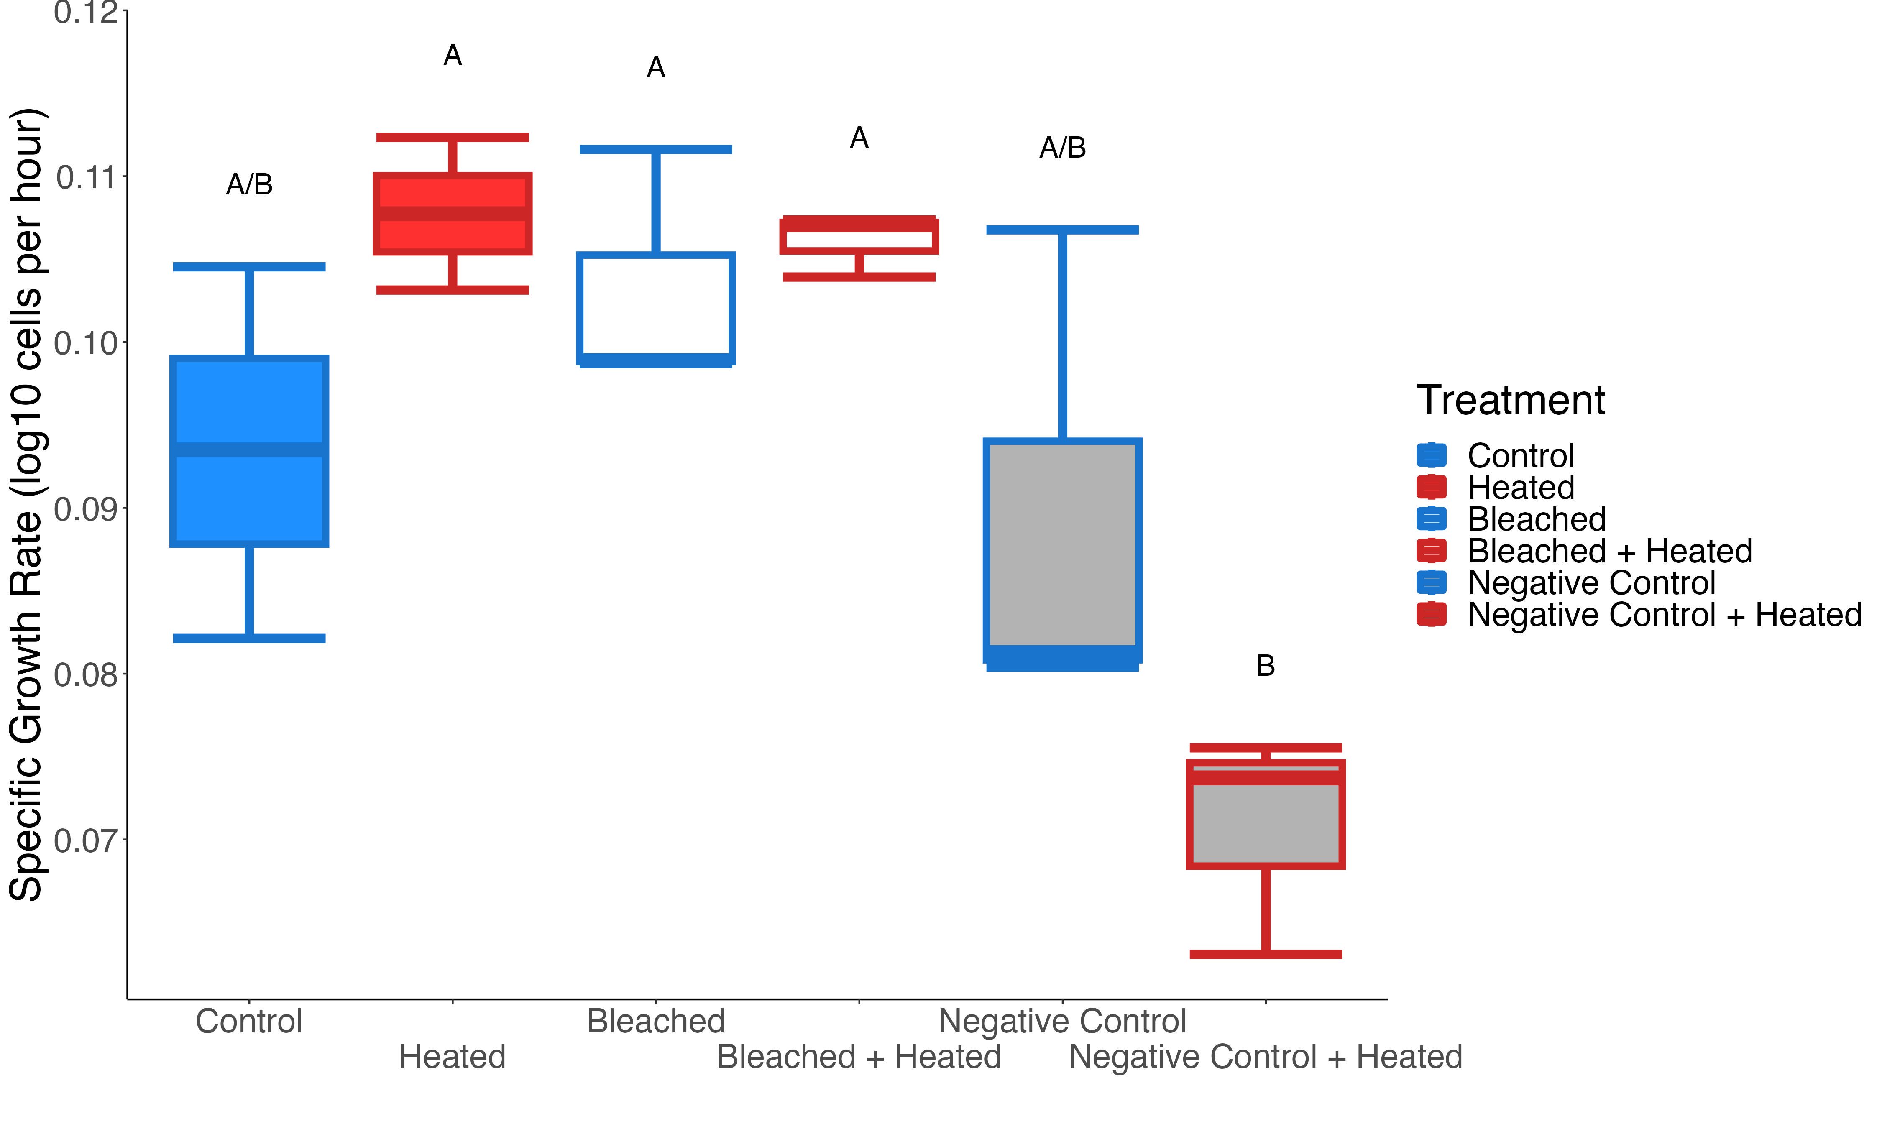
Figure S3: Box and whisker plots of bacterial specific growth rate, in log10 cells per hour, for the 6 treatments. Significant differences between treatments (Tukey post-hoc test, p<0.05) are denoted by letters above each boxplot.

Slide 4

Figure S4: Non-metric multidimensional scaling plot of bacterial communities from start and end of bottle incubation using unifrac dissimilarity.

Slide 5
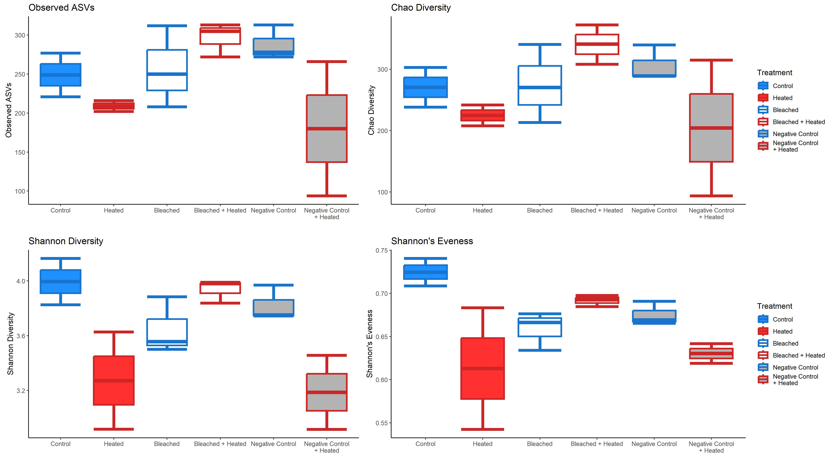
Figure S5: Box and whisker plots of the alpha diversity of the bacterial communities at the end of the incubation

Slide 6
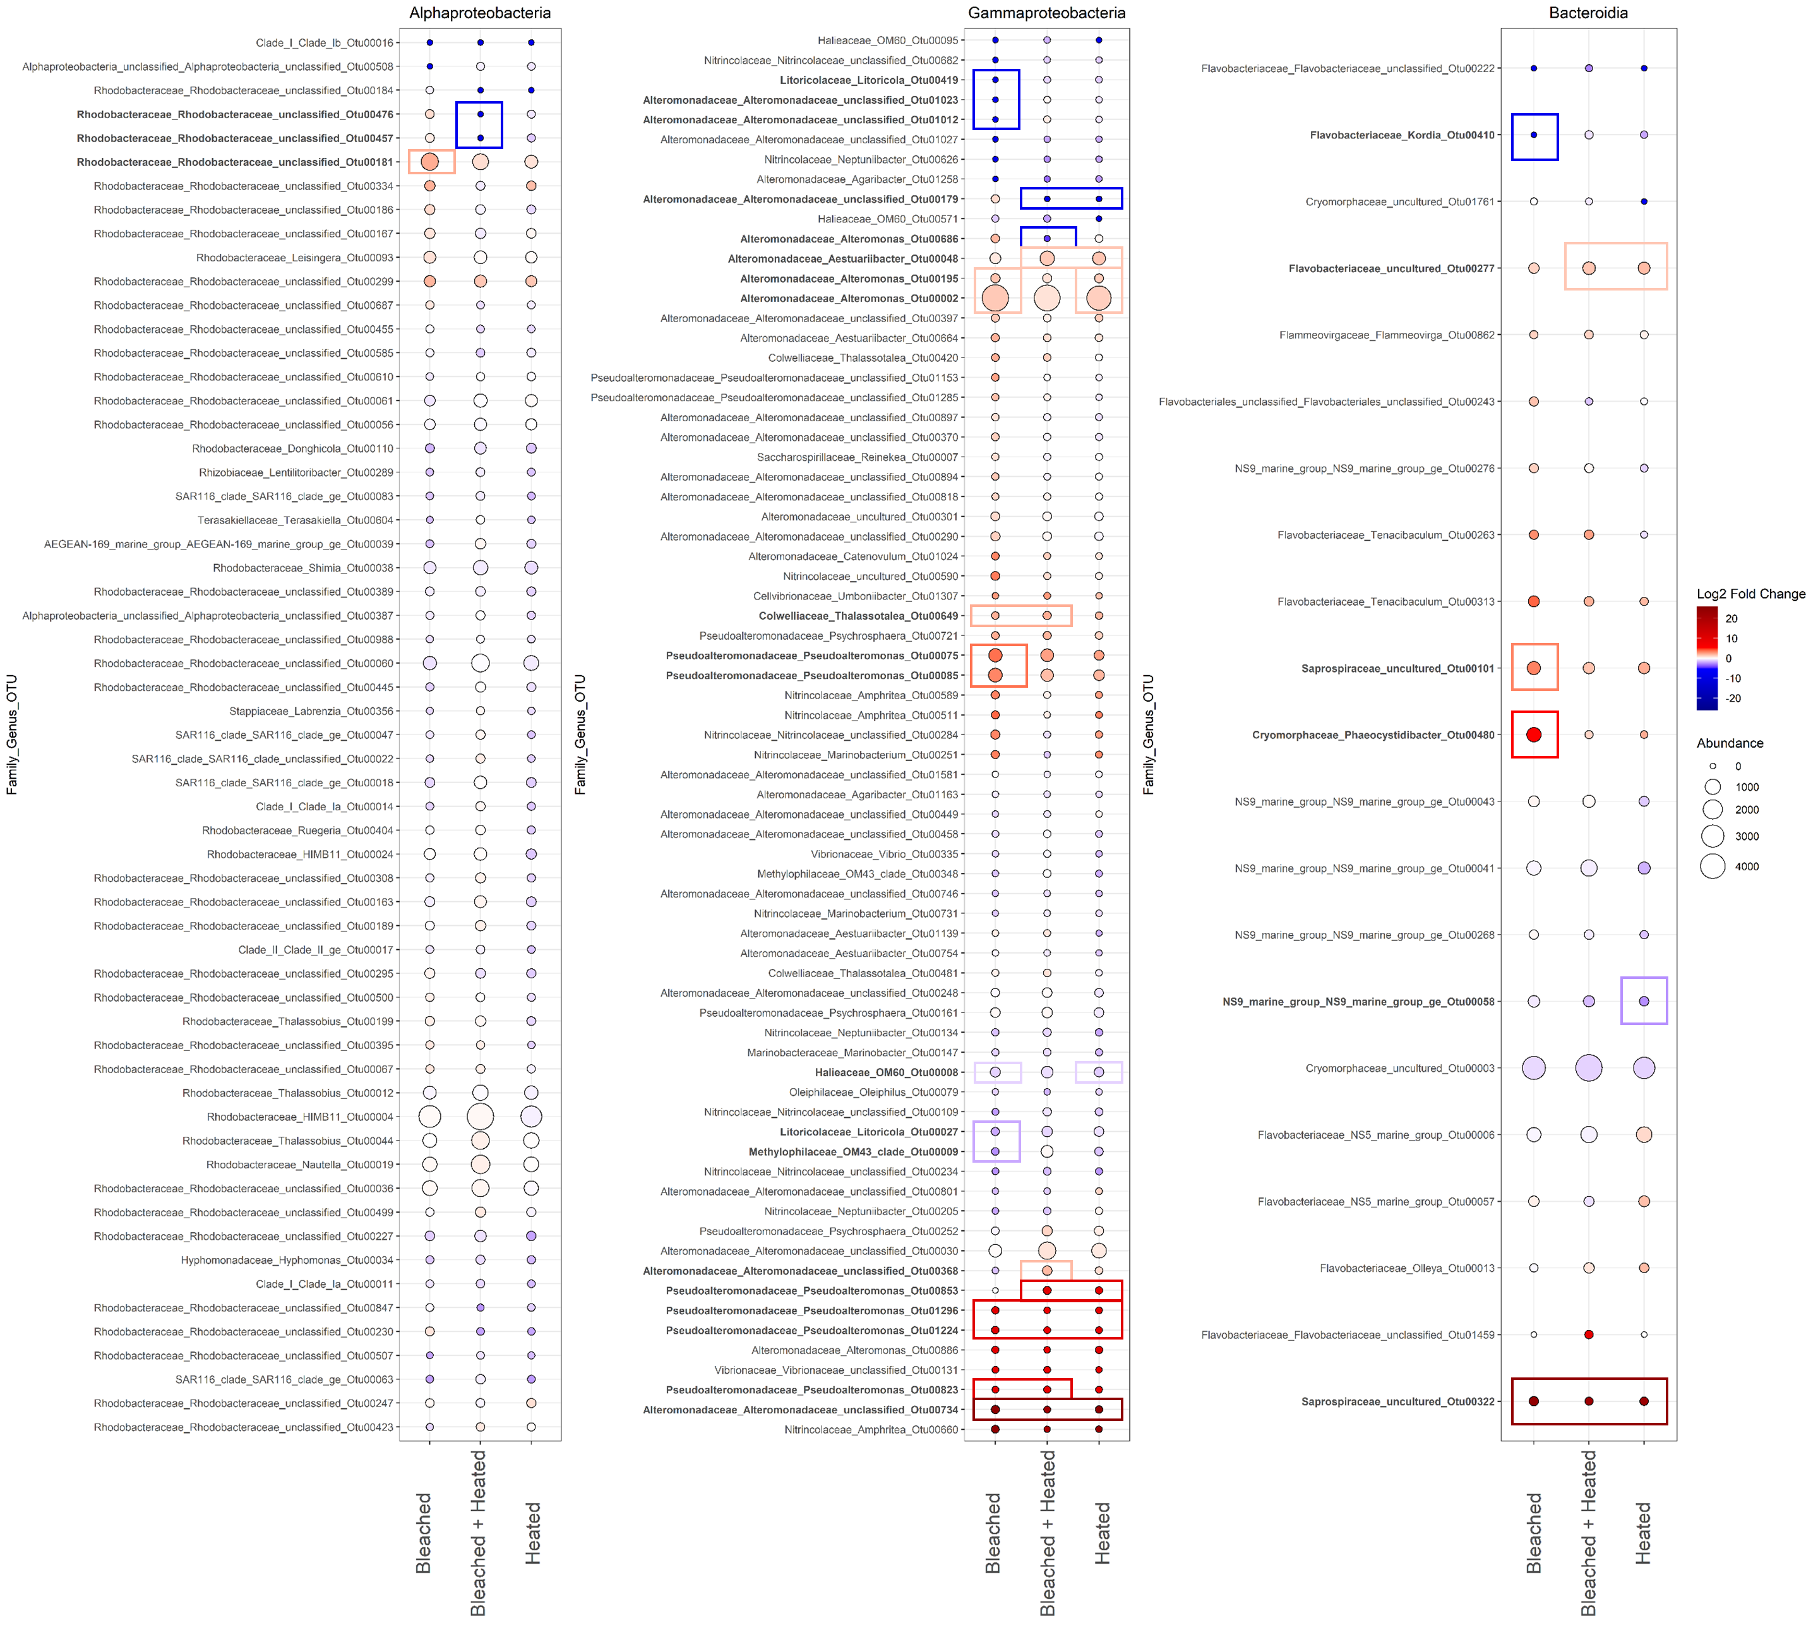
Figure S6: Direct comparison of bacterial OTUs enriched and/or depleted in the three stressed coral treatments relative to the Control corals. The log2 fold change of the 159 most abundant/prevalent OTUs in the three coral stress treatments compared to the Control treatment. Points are colored by log2 fold change, with warmer colors indicating more enrichment and cooler colors indicating more depletion relative to the Controls. Point size indicates the mean abundance of a given OTU in a given treatment. OTUs are labeled according to their family, genus, and OTU Number on the y axis. OTUs labeled in bold were determined by DESEq2 to be significantly differentially abundant in at least one of the three treatments compared to Controls (p≤.05 after FDR). Boxes denote in which treatment there is a significant change and the color of the box indicates whether this was a significant enrichment (red) or depletion (blue).

Slide 7
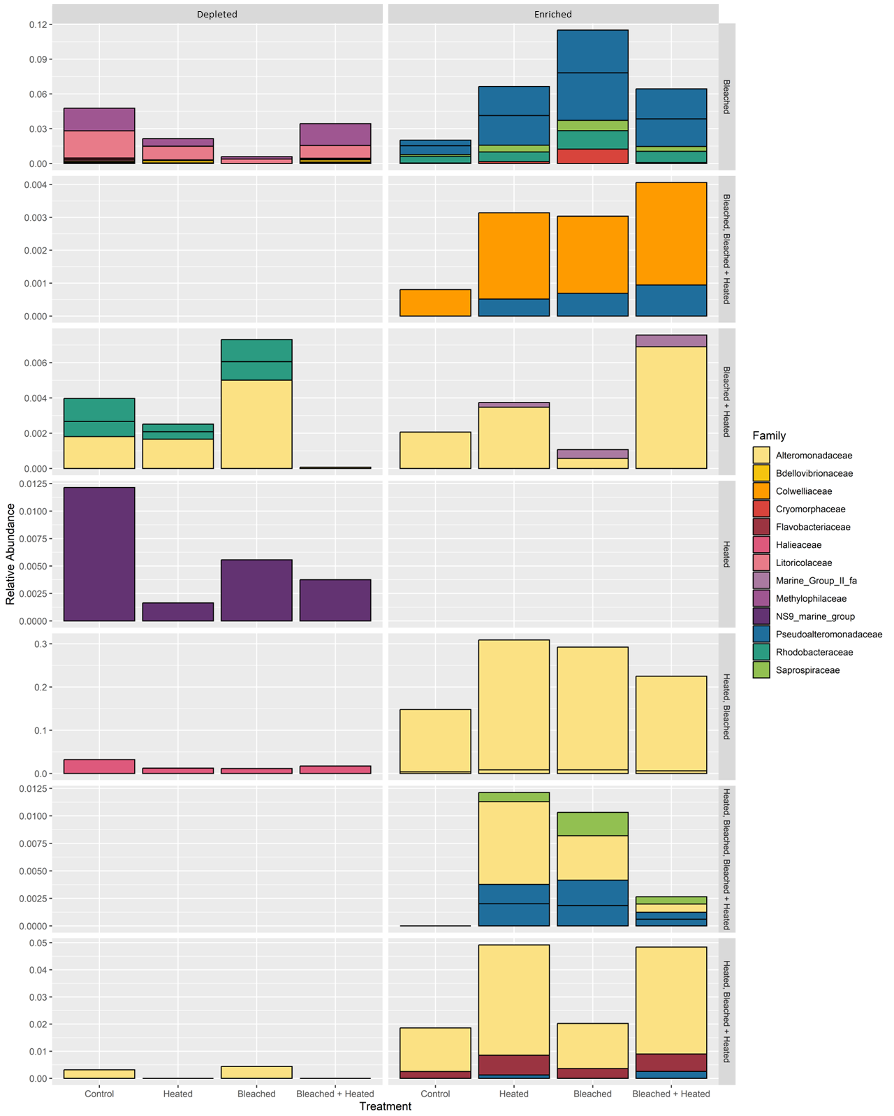
Figure S7: Stacked barplots of the relative abundance of significant OTUs (p≤.05 after FDR) enriched or depleted in any of the 3 coral stress treatments relative to the Control treatment according to DESEq2. Column facets denote if a given OTU is enriched or depleted relative to the Control. Row facets denote which treatments a group of OTUs is either significantly enriched or depleted in. Relative abundance was derived from the non-subsampled, raw abundance data used in DESEq2. Bars are colored according to bacterial family.

